Slide 1
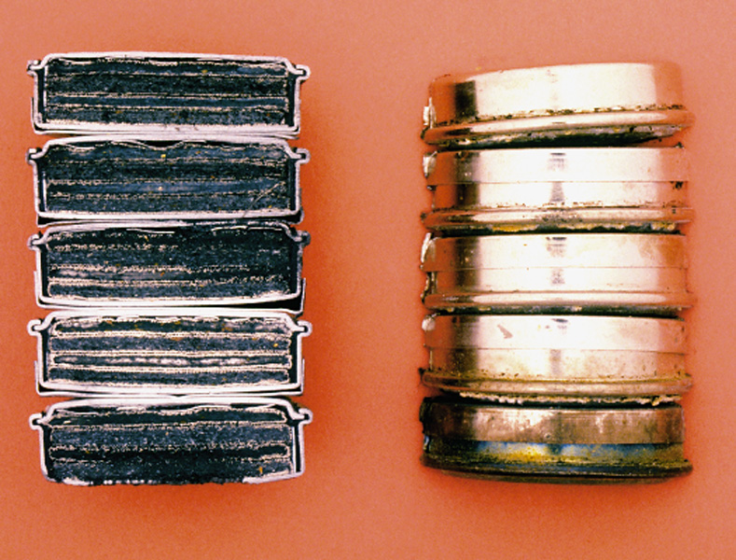
Electrochemical
Cells

Slide 2
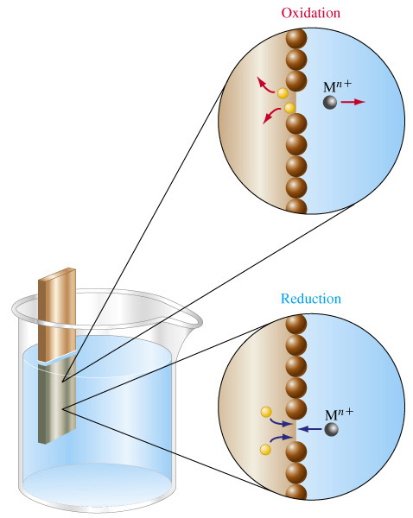
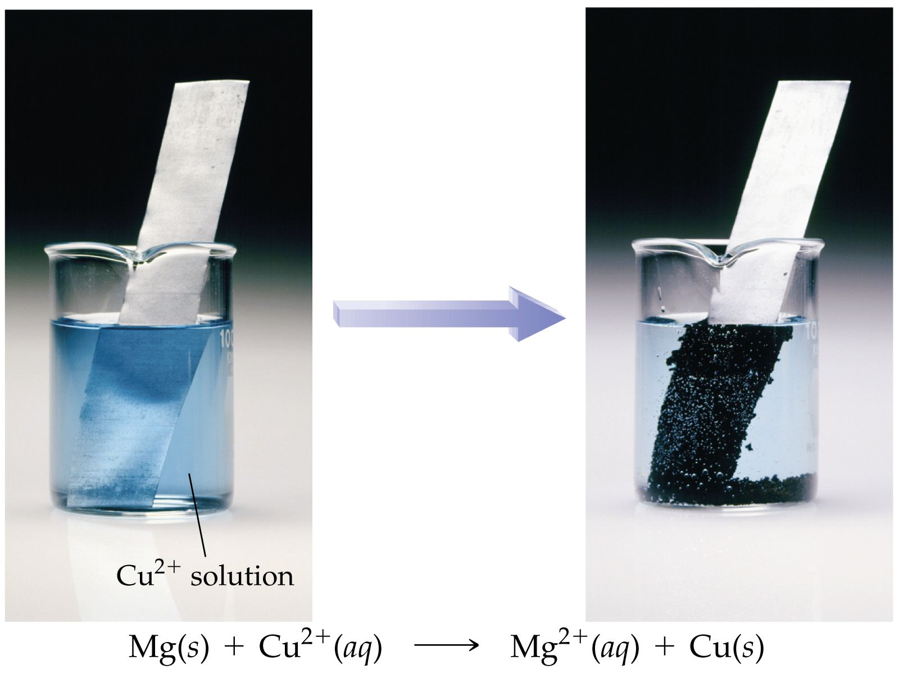
In redox reactions electrons are transferred.
Zn_{(s)} + Cu²⁺_{(aq)}   Zn²⁺_{(aq)} + Cu_{(s)}
2e⁻
This exchange of electrons takes place
at the solution-
metal interface.

Slide 3
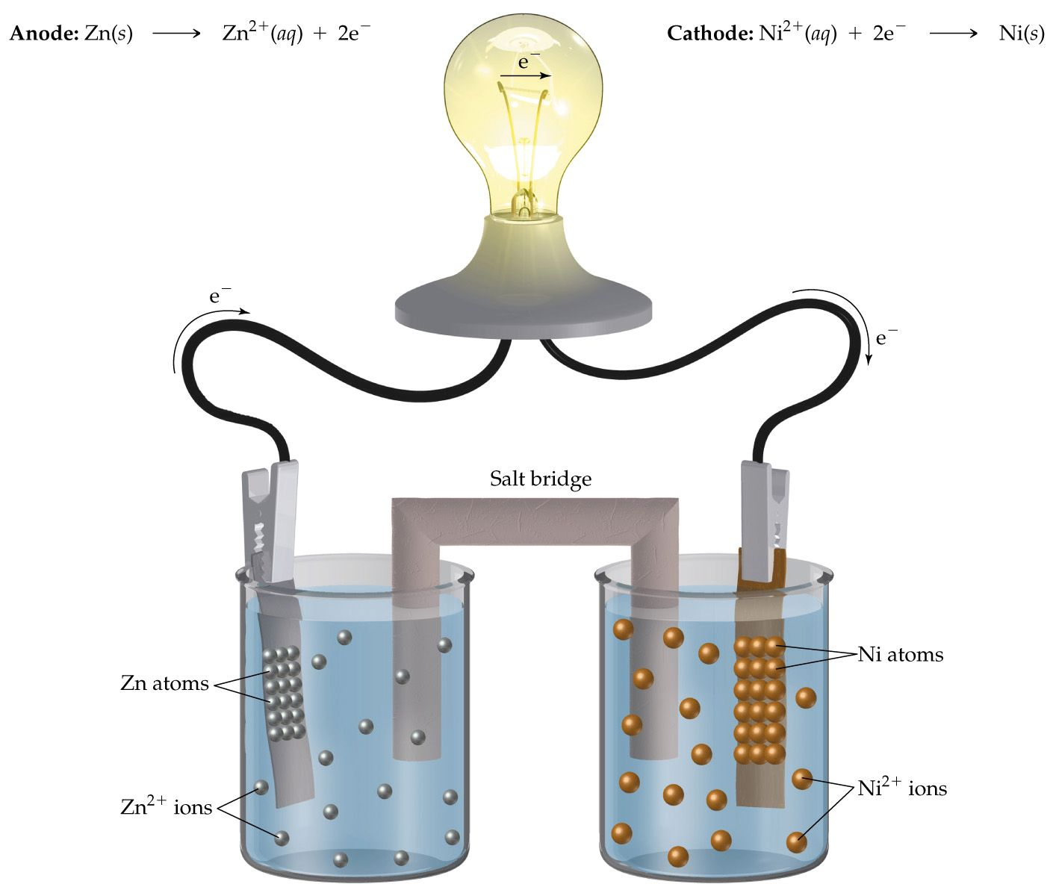
If we could separate the two half-reactions and link them by a wire we may be able to force the
This is exactly what happens in an electrochemical cell.
electrons to transfer externally.
Anode :
Zn → Zn²⁺ + 2e⁻
Cathode :
Ni²⁺ + 2e⁻ → Ni

Slide 4
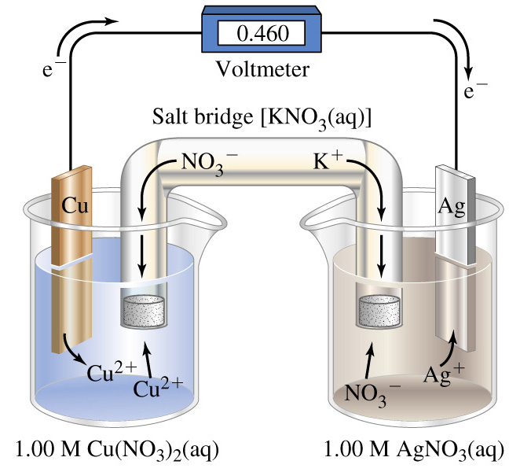
A salt bridge is used to complete the circuit and to allow balance of charge to be maintained in each solution.
Oxidation occurs at the anode.
Cu_{(s)} 
Cu²⁺_{(aq)} + 2e⁻
Electrons are generated here so it is designated negative (-ve).
Reduction occurs at the cathode.
Ag⁺_{(aq)} + e⁻  Ag_{(s)}
Electrons are accepted here so it is designated positive(+ve).

Slide 5
Electrochemical cells do not have to have to use consumable electrodes. Inert electrodes can be used. Electrochemical cells are also known as Voltaic Cells or Galvanic Cells.

Slide 6
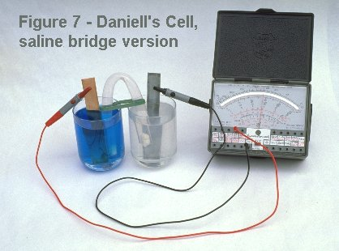
One of the first cells (developed in 1835), the Daniell Cell, was in fact based on these two half reactions :-
Zn_{(s)}   Zn²⁺_{(aq)} + 2e⁻
Cu²⁺_{(aq)}  + 2e⁻  Cu_{(s)}

Slide 7
Commercial
Cells & Batteries

Slide 8
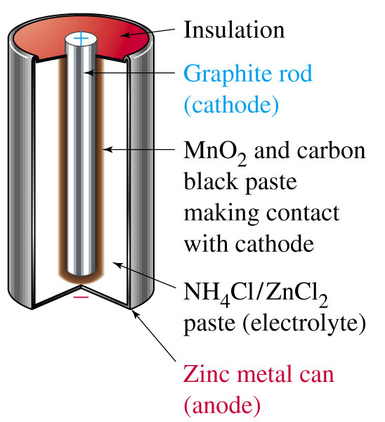
Dry Cells - Leclanche cells Common dry cell battery
The cell produces electricity by the reaction of zinc, found in the battery's case, and MnO₂, found in the battery's interior paste.
The half reactions are,
Anode : Zn → Zn²⁺ + 2 e⁻ (oxidation)
Cathode : 2 MnO₂ + 2 NH₄⁺ + 2 e⁻ → Mn₂O₃ + 2 NH₃ + H₂O (red.)

Slide 9
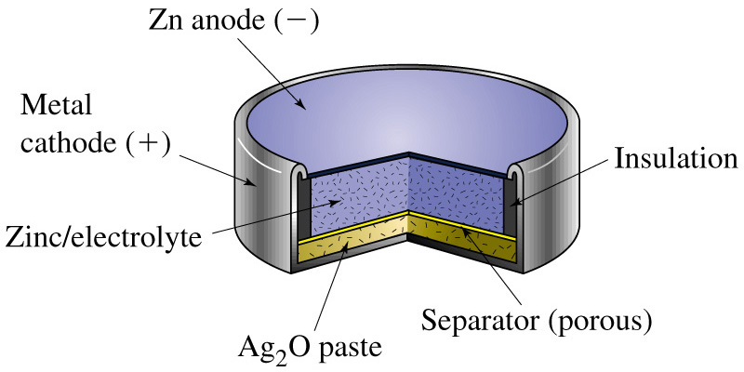
Dry Cells - Alkaline cells Common dry cell battery
These cells use 7 mol L-1 KOH instead of NH4Cl as the electrolyte. They are a superior cell to the Leclanche cell but are more expensive. On example is shown below.
The half reactions are,
Anode : Zn + 2OH⁻→ Zn(OH)₂ + 2 e⁻
Cath. : Ag₂O + H₂O + 2 e⁻ → 2Ag + 2OH⁻

Slide 10
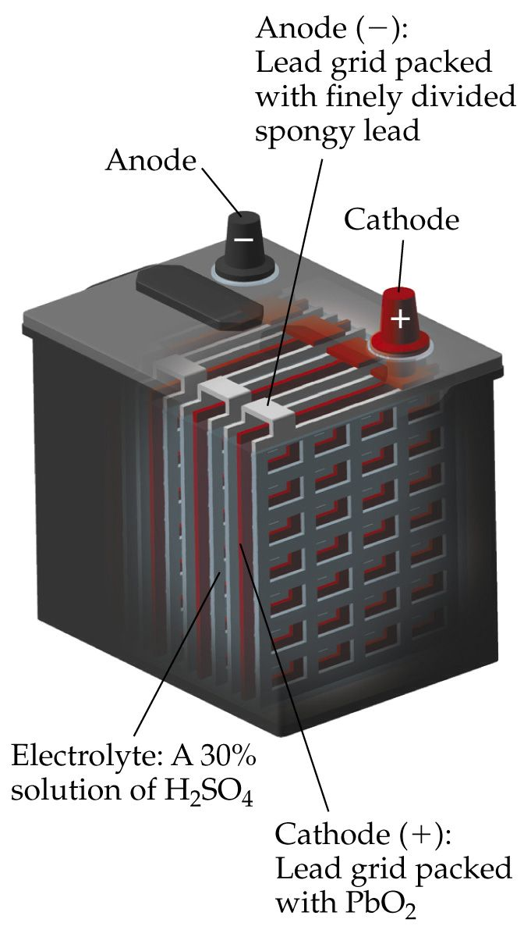
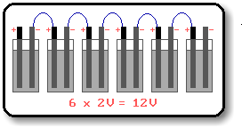
The Lead-Acid Battery.
A battery is a collection of 2 or more cells. The lead-acid battery consists of six 2 volt cells in series.
As the battery is used, the Pb and PbO₂ are converted to PbSO₄.

Slide 11




Lead-acid storage battery …ctd
When discharging (or supplying a current) the reactions are as follows :-
Anode :
Cathode :
Redox :
By applying an electric current to the battery, the PbSO₄ takes up the current's energy to convert it back into Pb and PbO₂.

Slide 12

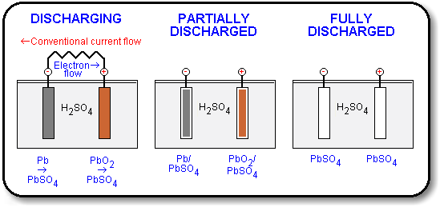
Lead-acid storage battery …ctd
By applying an electric current to the battery, the PbSO₄ takes up the current's energy to convert it back into Pb and PbO₂. The reactions are :-

Slide 13
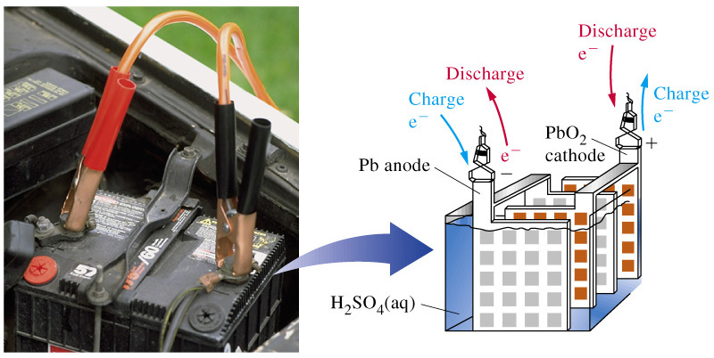
Lead-acid storage battery …ctd
By applying an electric current to the battery, the PbSO₄ takes up the current's energy to convert it back into Pb and PbO₂.

Slide 14
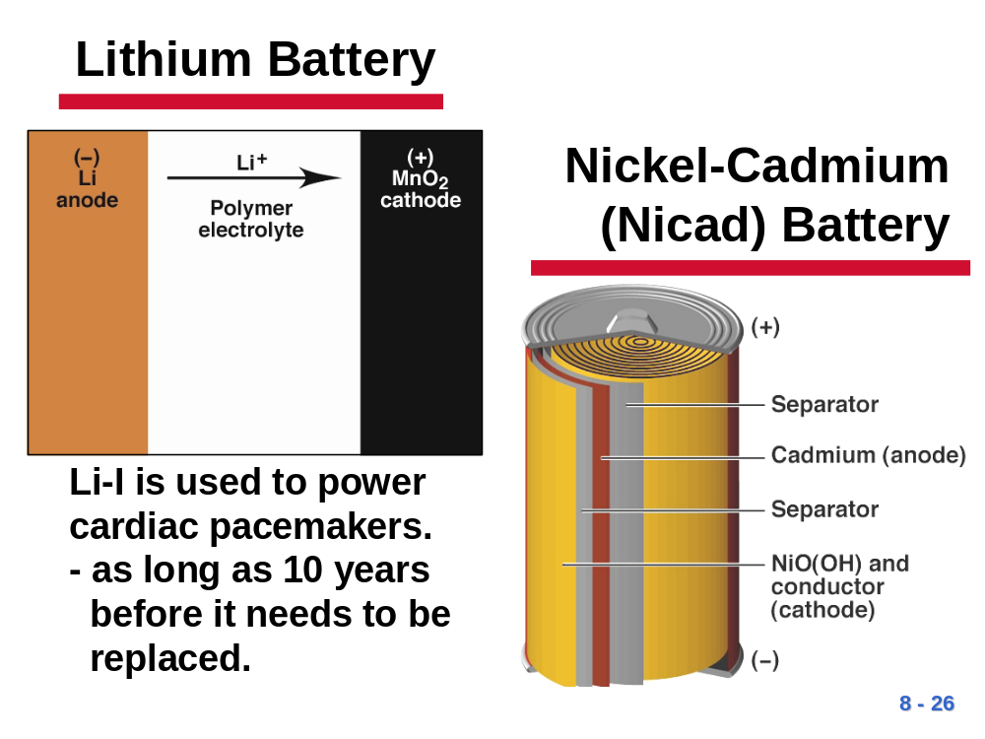

The Ni-Cad Cell.
Anode : Cd + 2OH⁻ → Cd(OH)₂ + 2e⁻
Cathode : NiO(OH) + H₂O + e- → Ni(OH)₂ + OH⁻
Overall : Cd + 2NiO(OH) + 2H₂O → Cd(OH)₂ + 2Ni(OH)₂
Used in rechargeable power tools, video cameras & portable music players.
It is rechargeable because the reaction products stick to the electrodes.
The electrolyte is KOH.
Button types are also available.

Slide 15
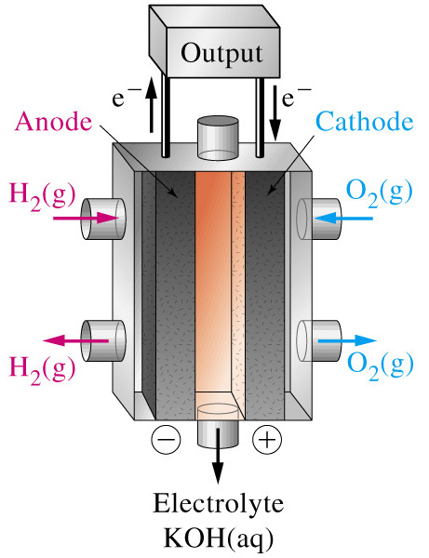


Fuel Cells.
The fuel cell combines hydrogen and oxygenwith a theoretical emf of 1.23V. Platinum is used as a catalyst, and the only by-product, water, is utilized by the spacecraft or submarine crews.
The Half-reactions are :-
With an overall reaction :-

Slide 16
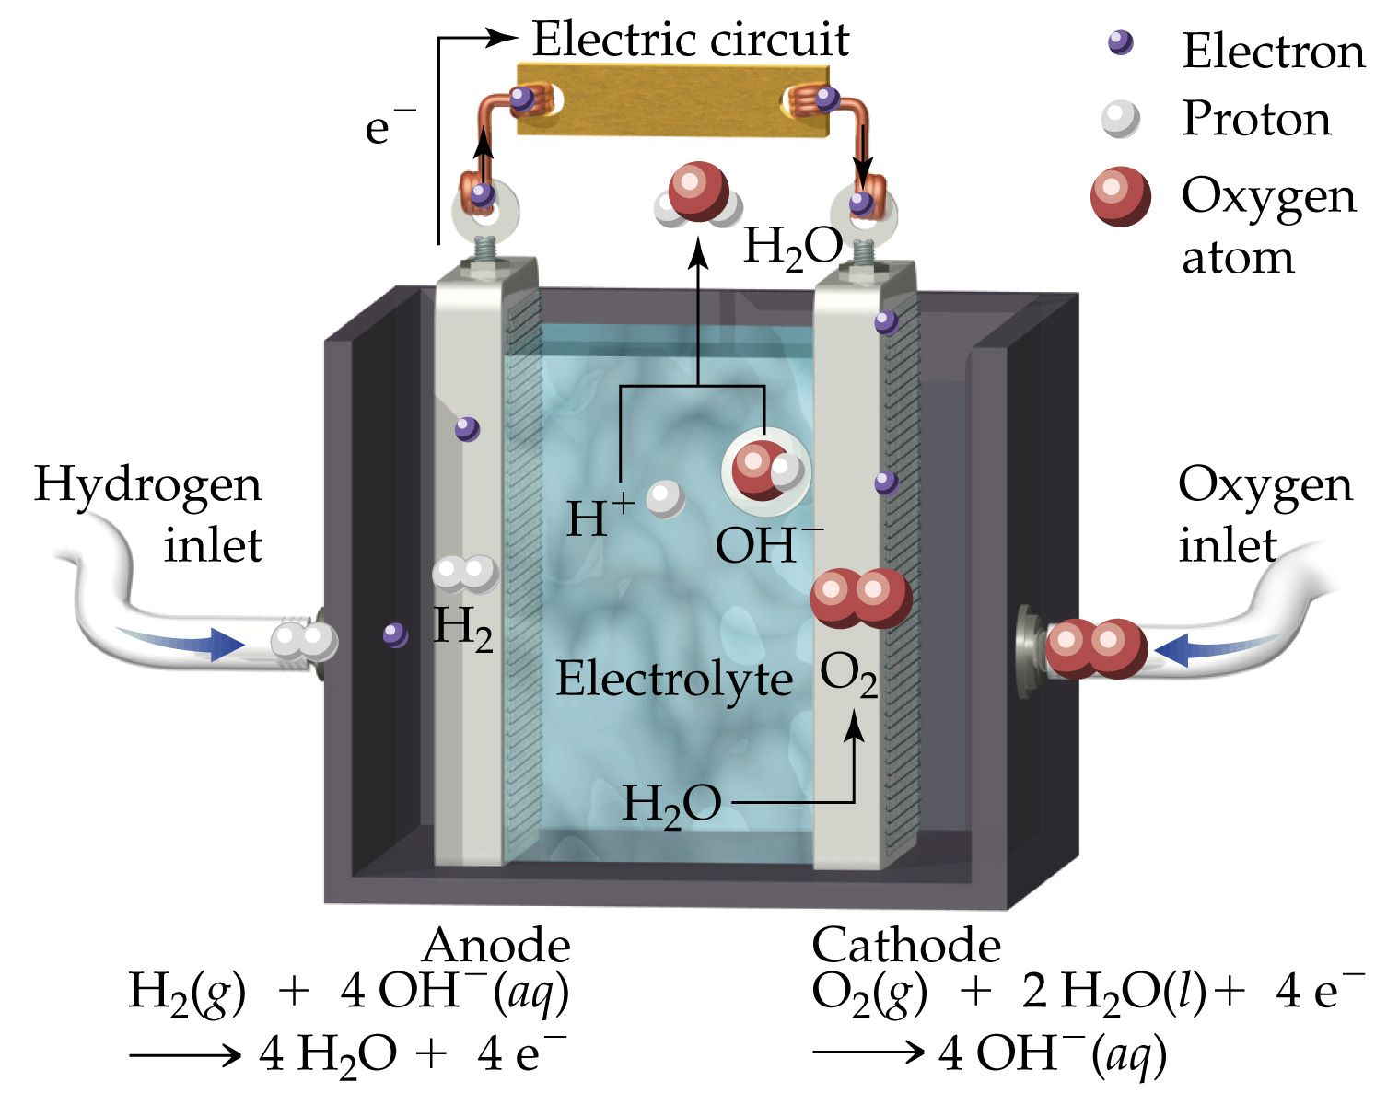
The Fuel Cell …ctd
If the electrolyte
is alkaline the reactions are :-

Slide 17
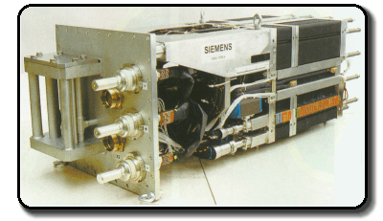
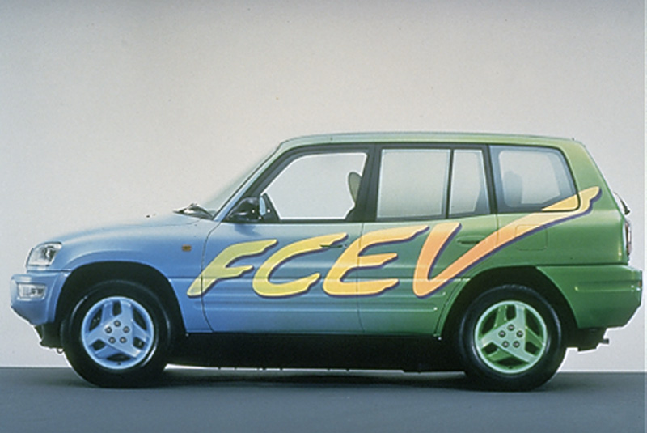
The Fuel Cell …ctd
Note that this fuel cell is not a primary cell, since neither reactants nor products are stored, or a secondary cell which can be recharged. Rather, the reactants have to be fed in continuously and the product removed.
Experimental Fuel Cell Car
Fuel Cell from a German Submarine.

Slide 18
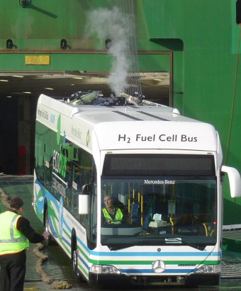
The Fuel Cell …ctd
Beginning in 2004, Perth began involvement in one of the first major trials of hydrogen fuel cell buses in the world. Three Daimler Chrysler hydrogen fuel cell buses will be trialled on normal Perth service routes for two years.
Experimental Fuel Cell Car

Slide 19
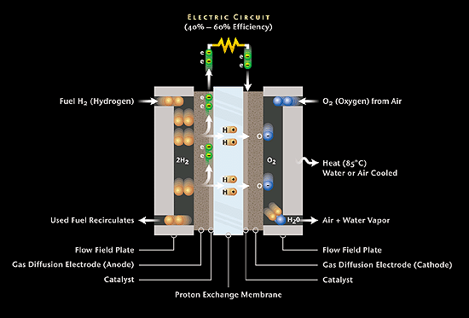
Ballard Power Systems

Slide 20
End of Slide Show
To Return to Year 12 Tutorial List
Choose Back from Menu above

